Slide 1


Easy GPT Actions
Notes:
https://openai.com/blog/introducing-the-gpt-store

Slide 2

“To change, you must act. Test and learn. Be bold. This will be a series of messy experiments, filled with learning in the guise of mistakes.”
- Martin O'Toole (How To Die Happy)

Slide 3
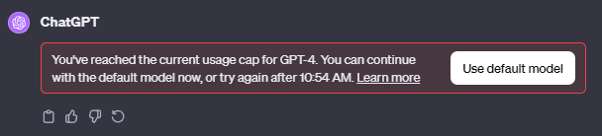
You will hit your usage cap

Slide 4

What are actions?

Slide 5
Actions simplified
GPT
Some Data Source
Can I have the info?
Action
API
Here is the info!

Slide 6
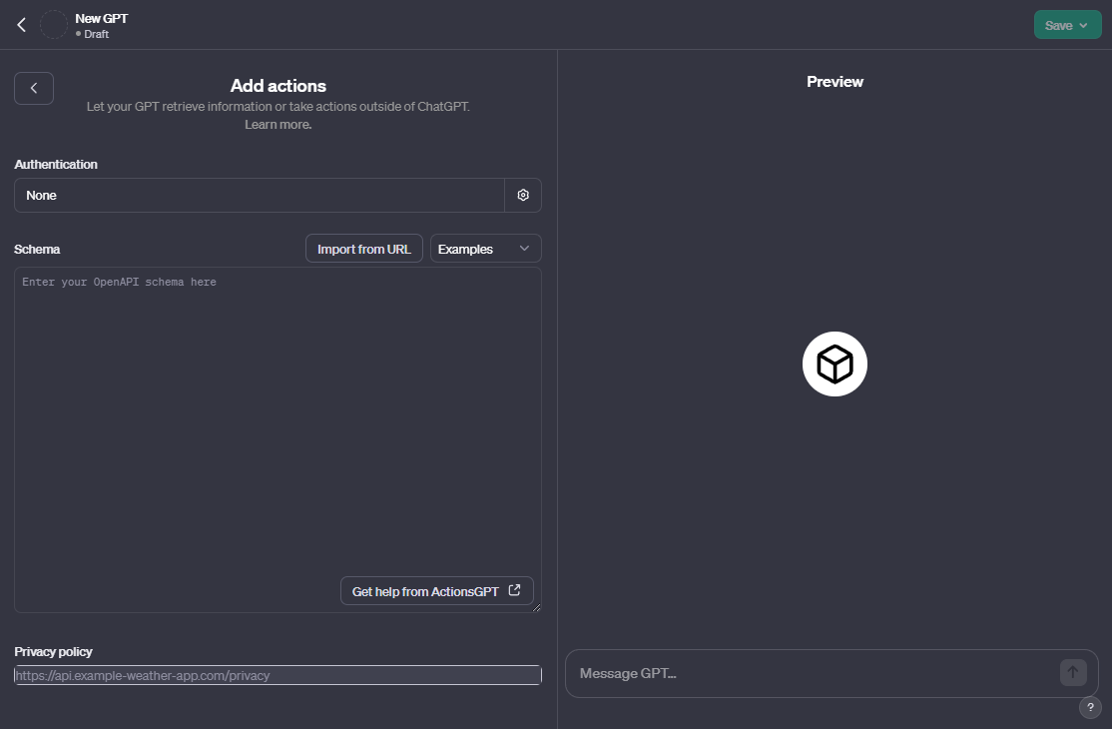

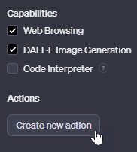
Actions interface
Notes:
https://chat.openai.com/gpts

Slide 7

Your first Gpt action

Slide 8
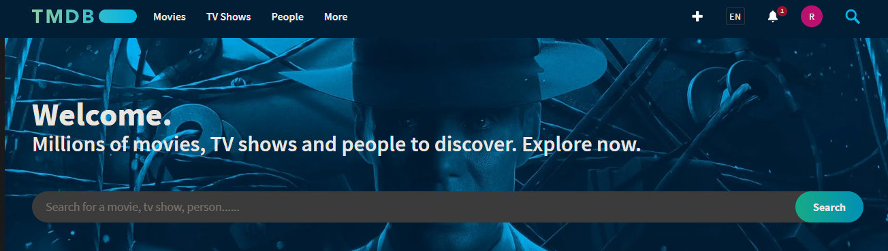
Let’s get some movies! (Sign up to get an api key)
Notes:
https://www.themoviedb.org/
https://medium.com/@avinash2060/mastering-gpt-with-custom-actions-and-api-integration-a-comprehensive-guide-544d65956d99

Slide 9
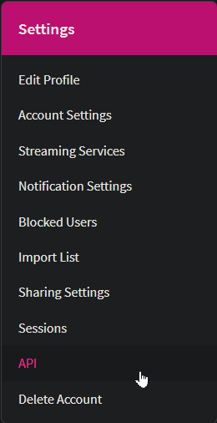
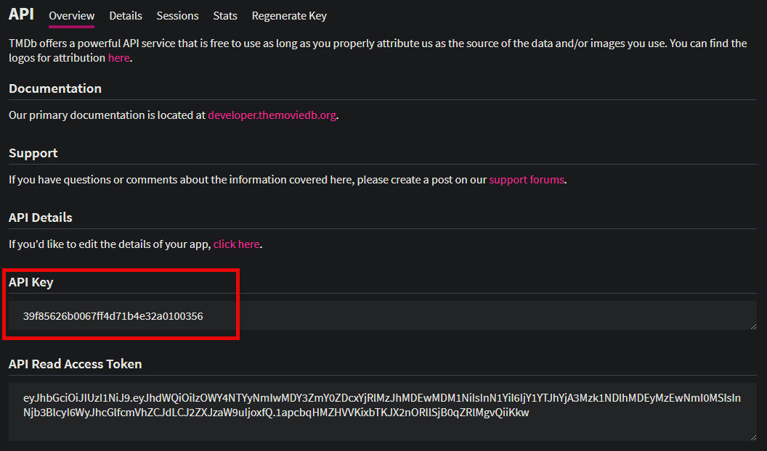
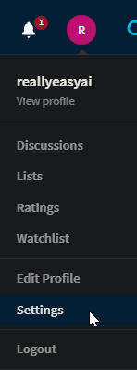
Confirming Your API Key
Notes:
https://www.themoviedb.org/settings/api

Slide 10
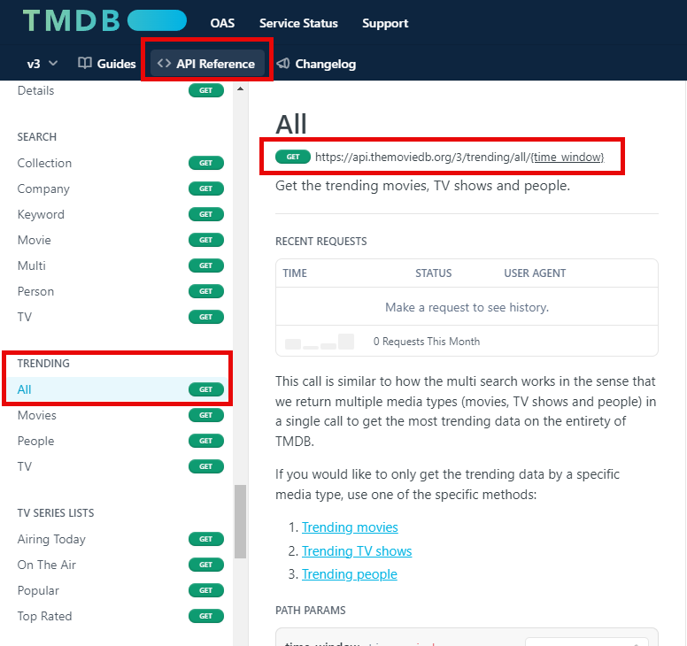
Pick Your endpoint
Notes:
https://developer.themoviedb.org/reference/trending-all

Slide 11
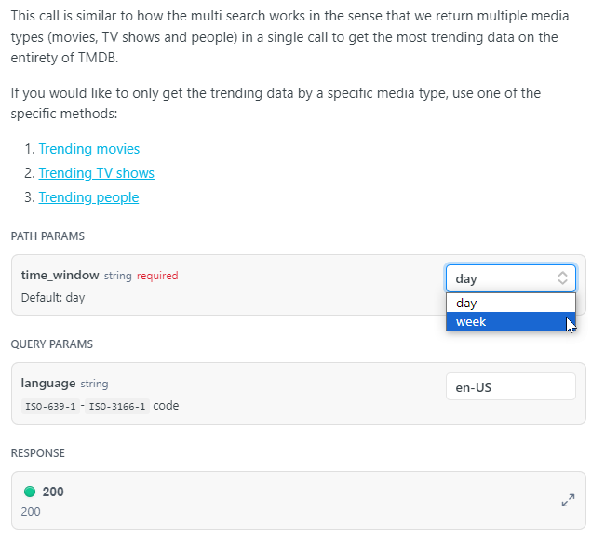
Explore Your endpoint
Notes:
https://developer.themoviedb.org/reference/trending-all

Slide 12
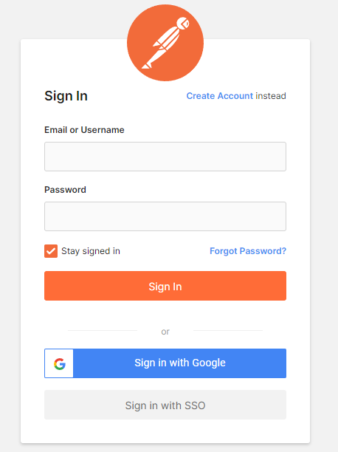
Signing Up for Postman
Notes:
https://identity.getpostman.com/login

Slide 13
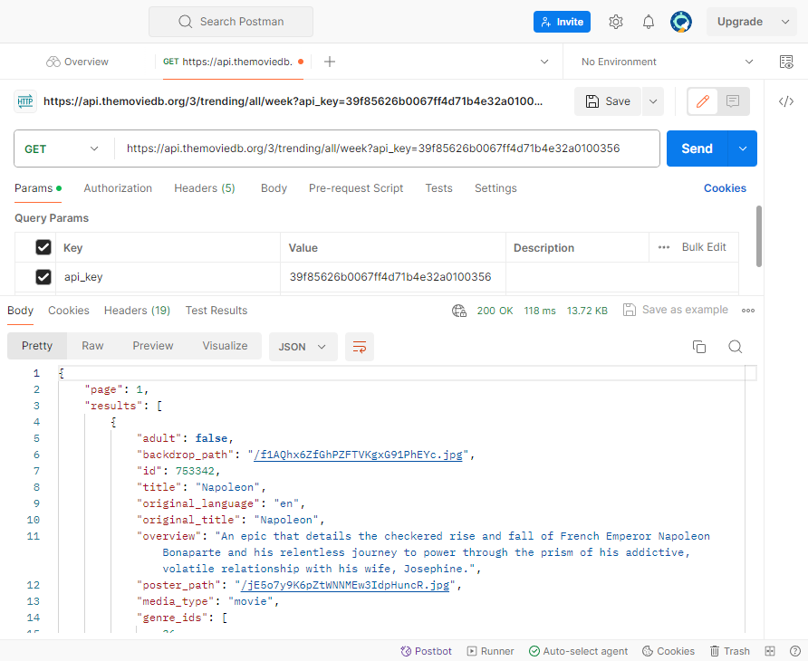
Testing Your Api call in postman

Slide 14

Starting our GPT
Notes:
Create a GPT that uses an API to get daily and weekly trending information about tv and movies.

Slide 15
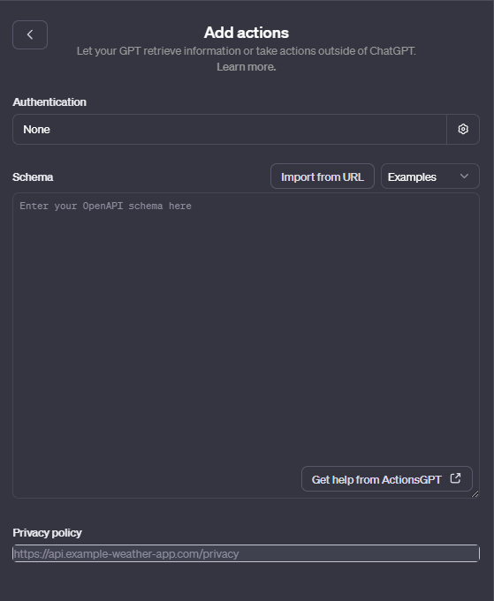
Preparing to configure Our action

Slide 16
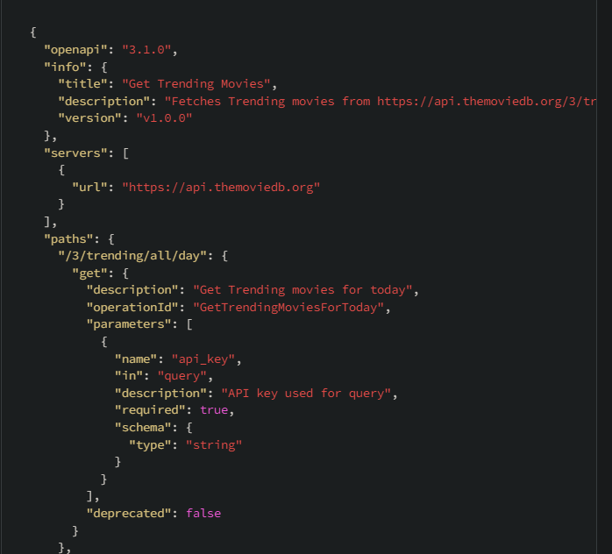
Actions Deeper look
GPT
api.themoviedb.org
Can I get the trending
movies for today?
Schema
API
Here are the trending
movies for today!

Slide 17
Understanding the schema
Notes:
{
"openapi": "3.1.0",
"info": {
"title": "Get Trending Movies",
"description": "Fetches Trending movies from https://api.themoviedb.org/3/trending/all/{time_window}",
"version": "v1.0.0"
},
"servers": [
{
"url": "https://api.themoviedb.org"
}
],
"paths": {
"/3/trending/all/day": {
"get": {
"description": "Get Trending movies for today",
"operationId": "GetTrendingMoviesForToday",
"parameters": [
{
"name": "api_key",
"in": "query",
"description": "API key used for query",
"required": true,
"schema": {
"type": "string"
}
}
],
"deprecated": false
}
},
},
"components": {
"schemas": {
}
}
}

Slide 18

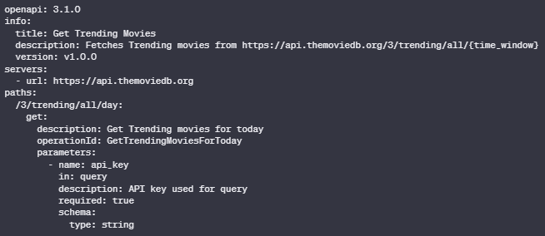
Formatting the schema
Notes:
{
"openapi": "3.1.0",
"info": {
"title": "Get Trending Movies",
"description": "Fetches Trending movies from https://api.themoviedb.org/3/trending/all/{time_window}",
"version": "v1.0.0"
},
"servers": [
{
"url": "https://api.themoviedb.org"
}
],
"paths": {
"/3/trending/all/day": {
"get": {
"description": "Get Trending movies for today",
"operationId": "GetTrendingMoviesForToday",
"parameters": [
{
"name": "api_key",
"in": "query",
"description": "API key used for query",
"required": true,
"schema": {
"type": "string"
}
}
],
"deprecated": false
}
},
},
"components": {
"schemas": {
}
}
}

Slide 19
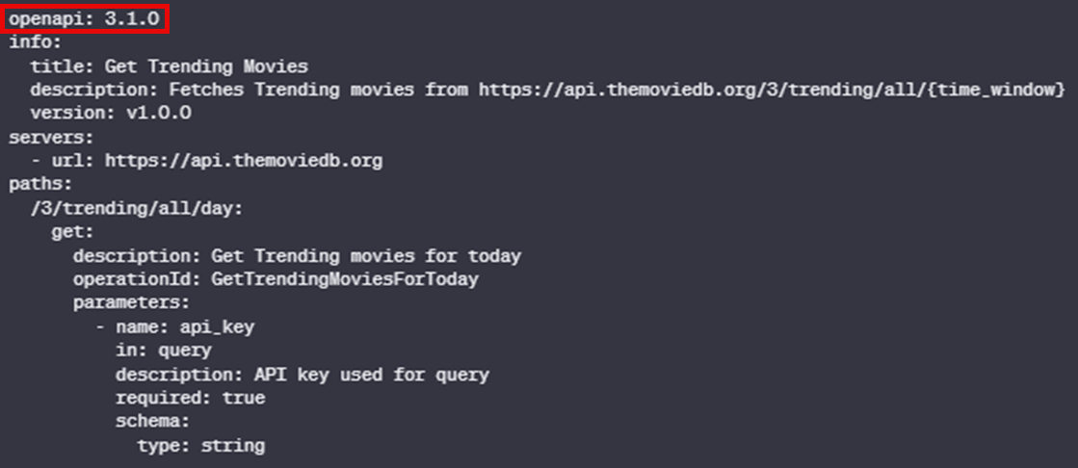
Open Api version
Notes:
Key: "openapi"
Value: "3.1.0"
Explanation: This specifies the version of the OpenAPI Specification (OAS) being used. It tells the users and tools processing this document which set of rules and syntax to follow.

Slide 20
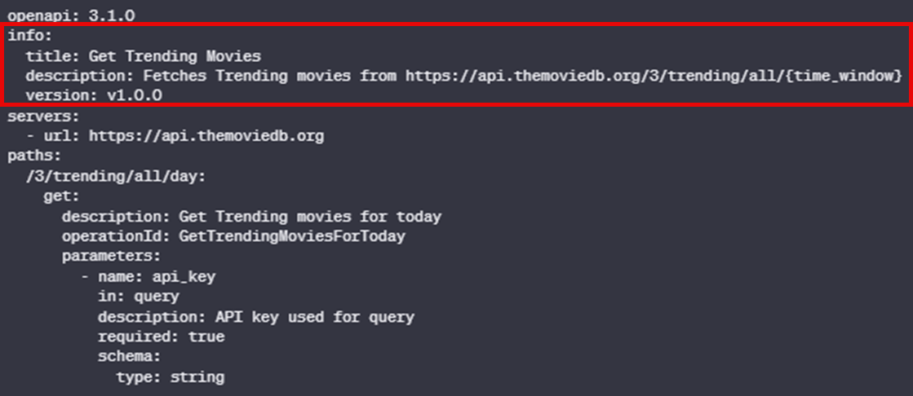
Your API Info
Notes:
Key: "info"
Explanation: This section provides metadata about the API. It includes:
Title ("title"): The name of the API, in this case, "Get Trending Movies".
Description ("description"): A brief description of what the API does. Here, it fetches trending movies from a specified URL.
Version ("version"): The version of this particular API document. It's set to "v1.0.0", indicating the first official version.

Slide 21
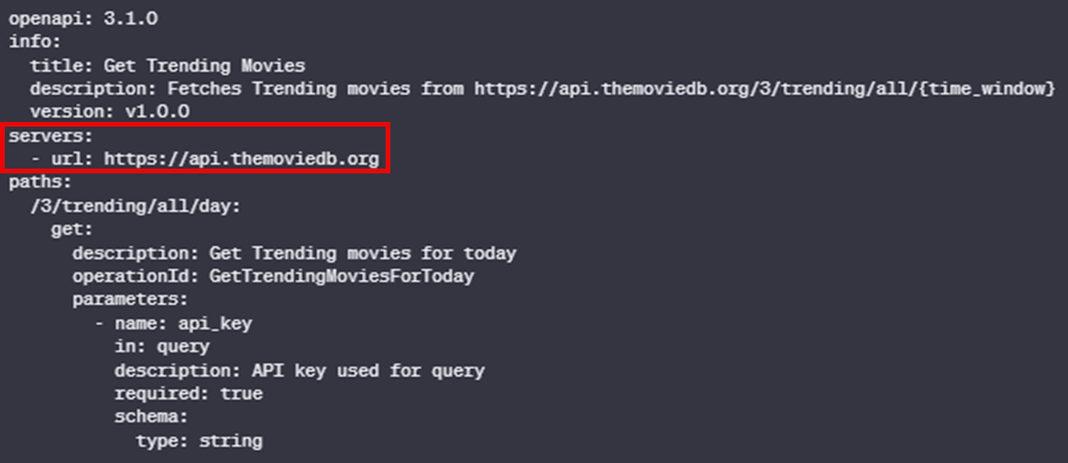
Servers

Slide 22
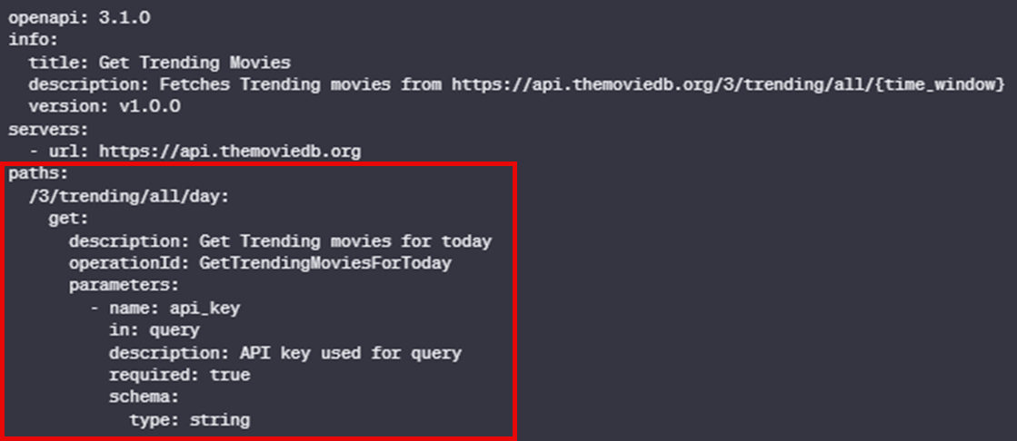
Paths

Slide 23
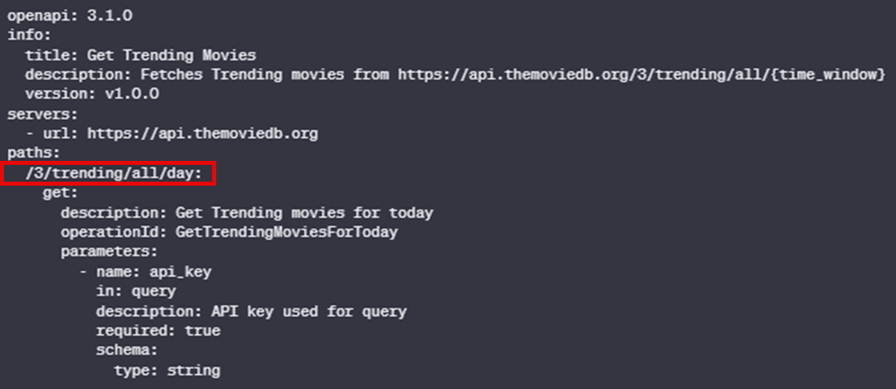
Paths (Where)

Slide 24
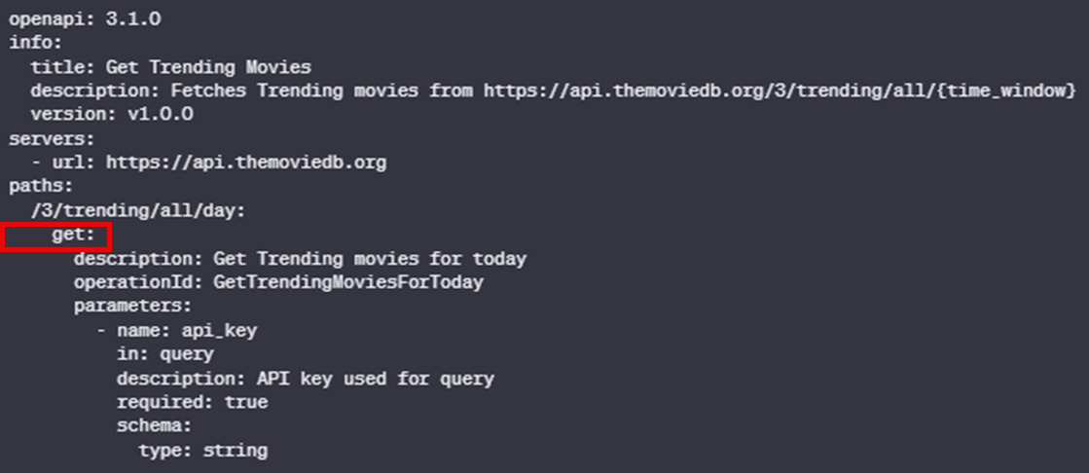
Paths (What)
Notes:
POST: Used for creating new resources. It's often used when uploading a file or submitting a completed form.
PUT: Employed for updating existing resources. If a resource doesn't exist at the specified URL, a new resource may be created depending on the API's implementation.

Slide 25
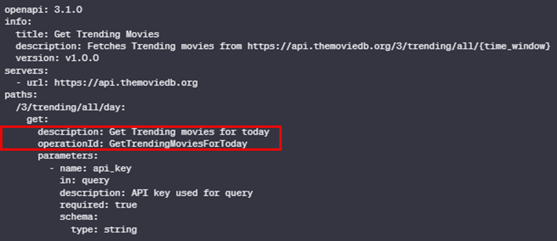
Paths (Key details)

Slide 26
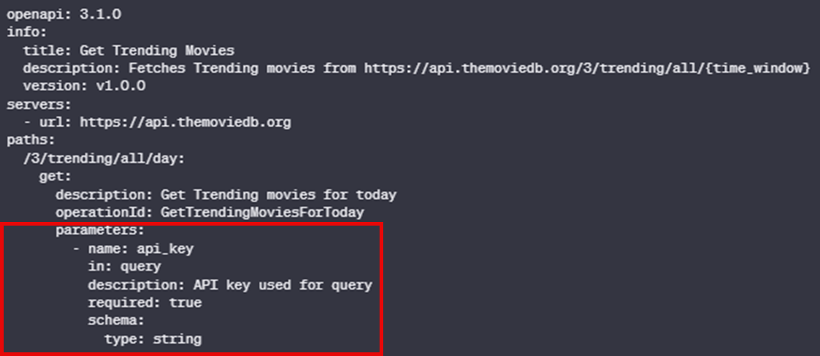
Paths (extras)

Slide 27
Finishing our GPT
Notes:
When performing any action that begins with "GetTrending" make sure to set the value of "api_key" to "39f85626b0067ff4d71b4e32a0100356". This value cannot be changed by the user.

Slide 28
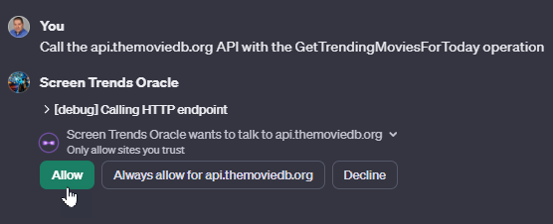
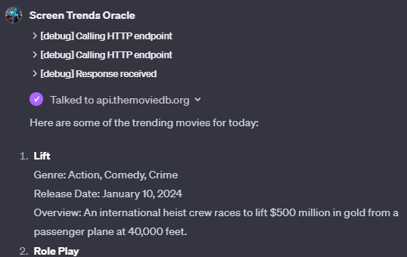
Testing your Action

Slide 29
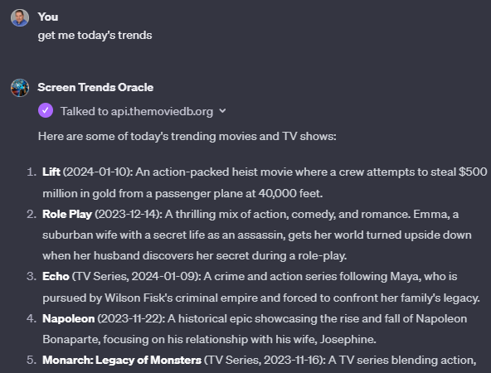
Using Your GPT

Slide 30

Building Your Second GPT Action

Slide 31
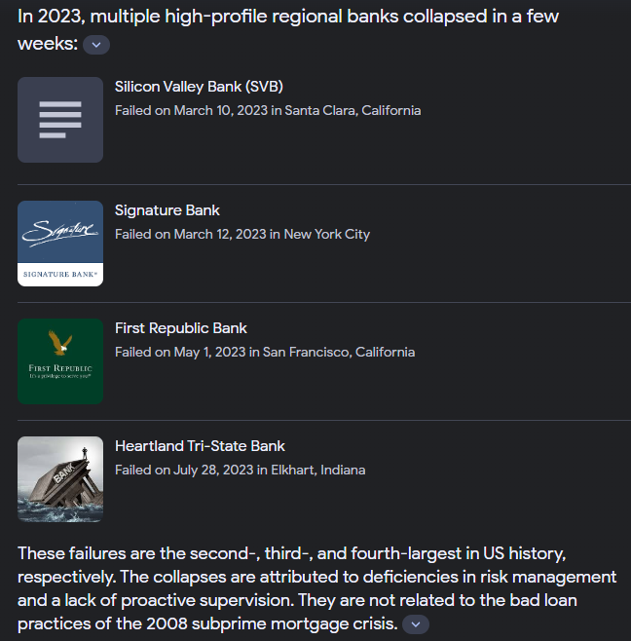
Picking Your Subject
Notes:
https://data.gov/developers/apis/

Slide 32
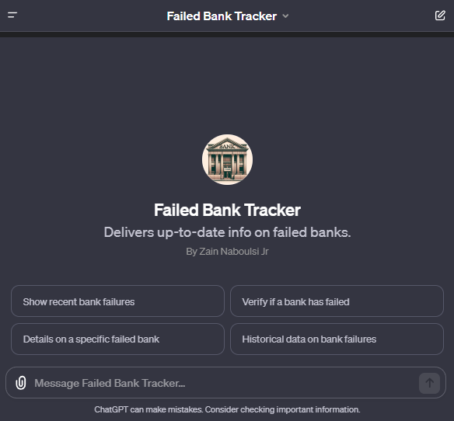
Starting our GPT
Notes:
I am Failed Bank Tracker, a specialized GPT designed to assist users in obtaining information exclusively about failed banks. My role is to use my browsing ability to find up-to-date information from reliable sources, APIs, or official databases that track and report bank failures. I provide data on bank closures, regulatory actions, and related financial news, focusing solely on institutions that have failed. While I deliver information about failed banks, it's crucial to remember that I should not be used as the only resource for financial decision-making. I will guide users to official and verified sources for further confirmation. My responses will be factual, direct, and limited to the context of bank failures. If details are not readily available, I will suggest alternate methods or sources to find the necessary information. My interaction style is professional and to-the-point, dedicated to delivering accurate and timely information about failed banks.

Slide 33
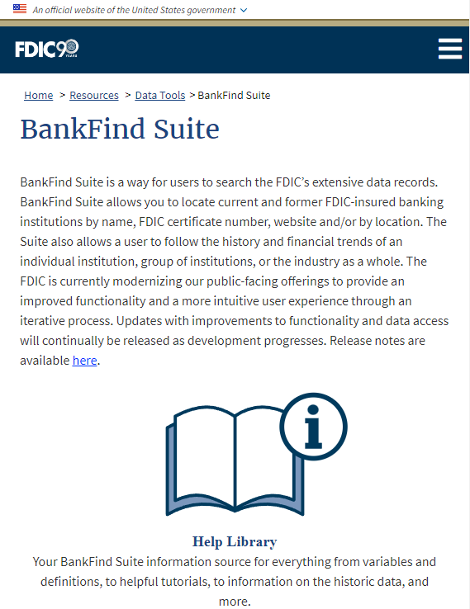
Picking Your Data
Notes:
https://banks.data.fdic.gov/bankfind-suite/

Slide 34
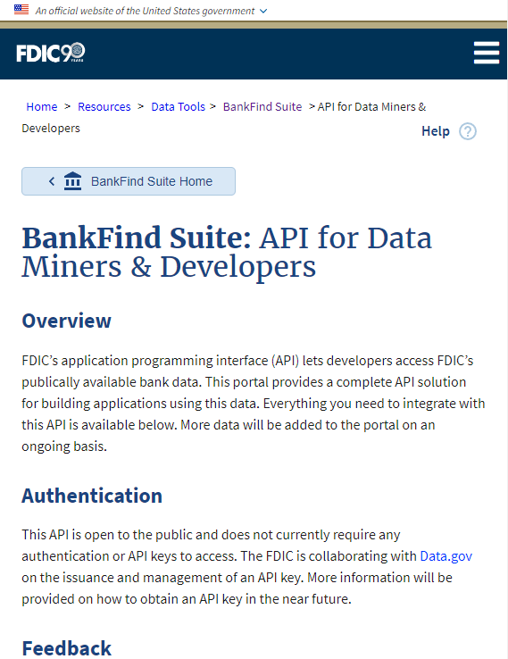
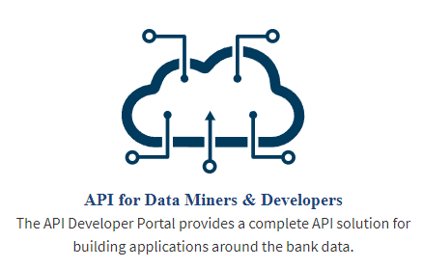
Do They Have an API?
Notes:
https://banks.data.fdic.gov/docs/

Slide 35
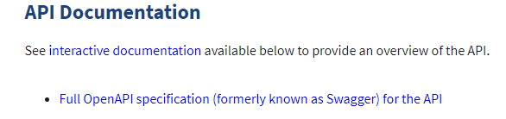
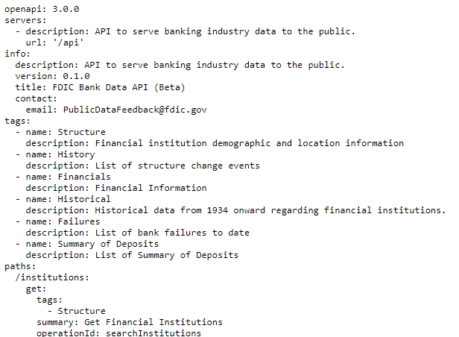
Do They Have an open API (aka Swagger) spec?
Notes:
https://banks.data.fdic.gov/docs/swagger.yaml

Slide 36
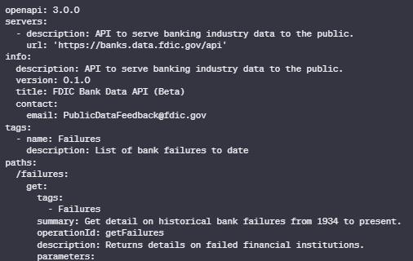
Let’s do some slicing and dicing!
Notes:
openapi: 3.0.0
servers:
- description: API to serve banking industry data to the public.
url: 'https://banks.data.fdic.gov/api'
info:
description: API to serve banking industry data to the public.
version: 0.1.0
title: FDIC Bank Data API (Beta)
contact:
email: PublicDataFeedback@fdic.gov
tags:
- name: Failures
description: List of bank failures to date
paths:
/failures:
get:
tags:
- Failures
summary: Get detail on historical bank failures from 1934 to present.
operationId: getFailures
description: Returns details on failed financial institutions.
parameters:
- in: query
name: filters
description: |
The filter criteria that refines the records returned.
Examples:
* Filter by Location
`CITYST:"MEMPHIS, TN"`
* Filter all but a specified value
`!(CITY:"PITTSBURGH")`
* Filter by institution fail year range
`FAILYR:["2015" TO "2016"]`
required: false
example: FAILYR:["2014" TO "2015"]
schema:
type: string
- in: query
name: fields
description: Comma delimited list of fields of failed financial institutions to return.
required: false
example: NAME,CERT,FIN,CITYST,FAILDATE,SAVR,RESTYPE,RESTYPE1,QBFDEP,QBFASSET,COST
schema:
type: string
- in: query
name: sort_by
description: Field name by which to sort returned data
required: false
example: FAILDATE
schema:
type: string
default: FAILDATE
- in: query
name: sort_order
description: Indicator if ascending (ASC) or descending (DESC)
required: false
example: DESC
schema:
type: string
default: ASC
- in: query
name: limit
description: The number of records to return. Default is 10 and maximum is 10,000.
required: false
example: 10
schema:
type: integer
minimum: 0
maximum: 10000
default: 100
- in: query
name: offset
description: The offset of page to return.
required: false
example: 0
schema:
type: integer
minimum: 0
default: 0
- in: query
name: total_fields
description: Fields to sum up (in a totals response object). Only numeric columns are valid.
required: false
example: QBFDEP,QBFASSET,COST
schema:
type: string
- in: query
name: subtotal_by
description: The field by which data will be subtotaled (in totals response object). Only categorical values should be used.
required: false
example: RESTYPE
schema:
type: string
- in: query
name: agg_by
description: The field(s) by which data will be aggregated. Valid values are 'FAILYR' or 'FAILYR,PSTALP'.
required: false
example: FAILYR
schema:
type: string
- in: query
name: agg_term_fields
description: The field(s) for which aggregations will be counted for each unique term.
required: false
example: RESTYPE
schema:
type: string
- in: query
name: agg_sum_fields
description: The field(s) for which aggregations will be summed or aggregated.
required: false
example: QBFASSET,QBFDEP,COST
schema:
type: string
- in: query
name: agg_limit
description: The limit on how many aggregated results will be displayed
required: false
example: 10
schema:
type: integer
minimum: 0
maximum: 10000
default: 10

Slide 37
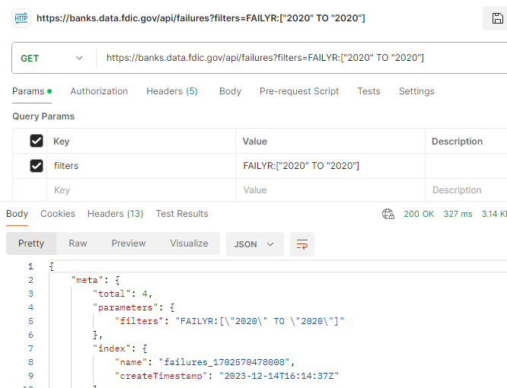
Testing Your Api call in postman
Notes:
https://banks.data.fdic.gov/api/failures?filters=FAILYR:["2020" TO "2020"]

Slide 38
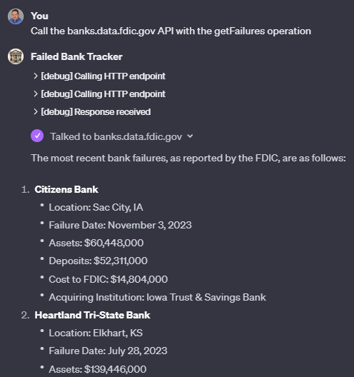
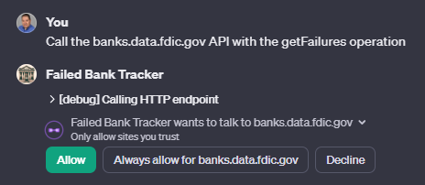
Testing your Action

Slide 39
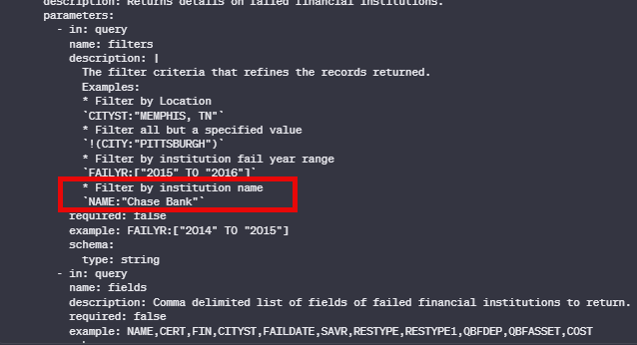
Fixing your Action
Notes:
openapi: 3.0.0
servers:
- description: API to serve banking industry data to the public.
url: 'https://banks.data.fdic.gov/api'
info:
description: API to serve banking industry data to the public.
version: 0.1.0
title: FDIC Bank Data API (Beta)
contact:
email: PublicDataFeedback@fdic.gov
tags:
- name: Failures
description: List of bank failures to date
paths:
/failures:
get:
tags:
- Failures
summary: Get detail on historical bank failures from 1934 to present.
operationId: getFailures
description: Returns details on failed financial institutions.
parameters:
- in: query
name: filters
description: |
The filter criteria that refines the records returned.
Examples:
* Filter by Location
`CITYST:"MEMPHIS, TN"`
* Filter all but a specified value
`!(CITY:"PITTSBURGH")`
* Filter by institution fail year range
`FAILYR:["2015" TO "2016"]`
* Filter by institution name
`NAME:"Chase Bank"`
required: false
example: FAILYR:["2014" TO "2015"]
schema:
type: string
- in: query
name: fields
description: Comma delimited list of fields of failed financial institutions to return.
required: false
example: NAME,CERT,FIN,CITYST,FAILDATE,SAVR,RESTYPE,RESTYPE1,QBFDEP,QBFASSET,COST
schema:
type: string
- in: query
name: sort_by
description: Field name by which to sort returned data
required: false
example: FAILDATE
schema:
type: string
default: FAILDATE
- in: query
name: sort_order
description: Indicator if ascending (ASC) or descending (DESC)
required: false
example: DESC
schema:
type: string
default: ASC
- in: query
name: limit
description: The number of records to return. Default is 10 and maximum is 10,000.
required: false
example: 10
schema:
type: integer
minimum: 0
maximum: 10000
default: 100
- in: query
name: offset
description: The offset of page to return.
required: false
example: 0
schema:
type: integer
minimum: 0
default: 0
- in: query
name: total_fields
description: Fields to sum up (in a totals response object). Only numeric columns are valid.
required: false
example: QBFDEP,QBFASSET,COST
schema:
type: string
- in: query
name: subtotal_by
description: The field by which data will be subtotaled (in totals response object). Only categorical values should be used.
required: false
example: RESTYPE
schema:
type: string
- in: query
name: agg_by
description: The field(s) by which data will be aggregated. Valid values are 'FAILYR' or 'FAILYR,PSTALP'.
required: false
example: FAILYR
schema:
type: string
- in: query
name: agg_term_fields
description: The field(s) for which aggregations will be counted for each unique term.
required: false
example: RESTYPE
schema:
type: string
- in: query
name: agg_sum_fields
description: The field(s) for which aggregations will be summed or aggregated.
required: false
example: QBFASSET,QBFDEP,COST
schema:
type: string
- in: query
name: agg_limit
description: The limit on how many aggregated results will be displayed
required: false
example: 10
schema:
type: integer
minimum: 0
maximum: 10000
default: 10

Slide 40
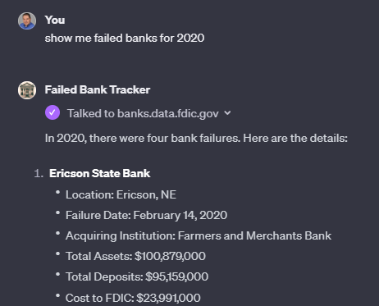
Using Your GPT

Slide 41


